Slide 1
Sales Insights dashboard
File created on: 12/21/2021 5:07:59 PM

Slide 2
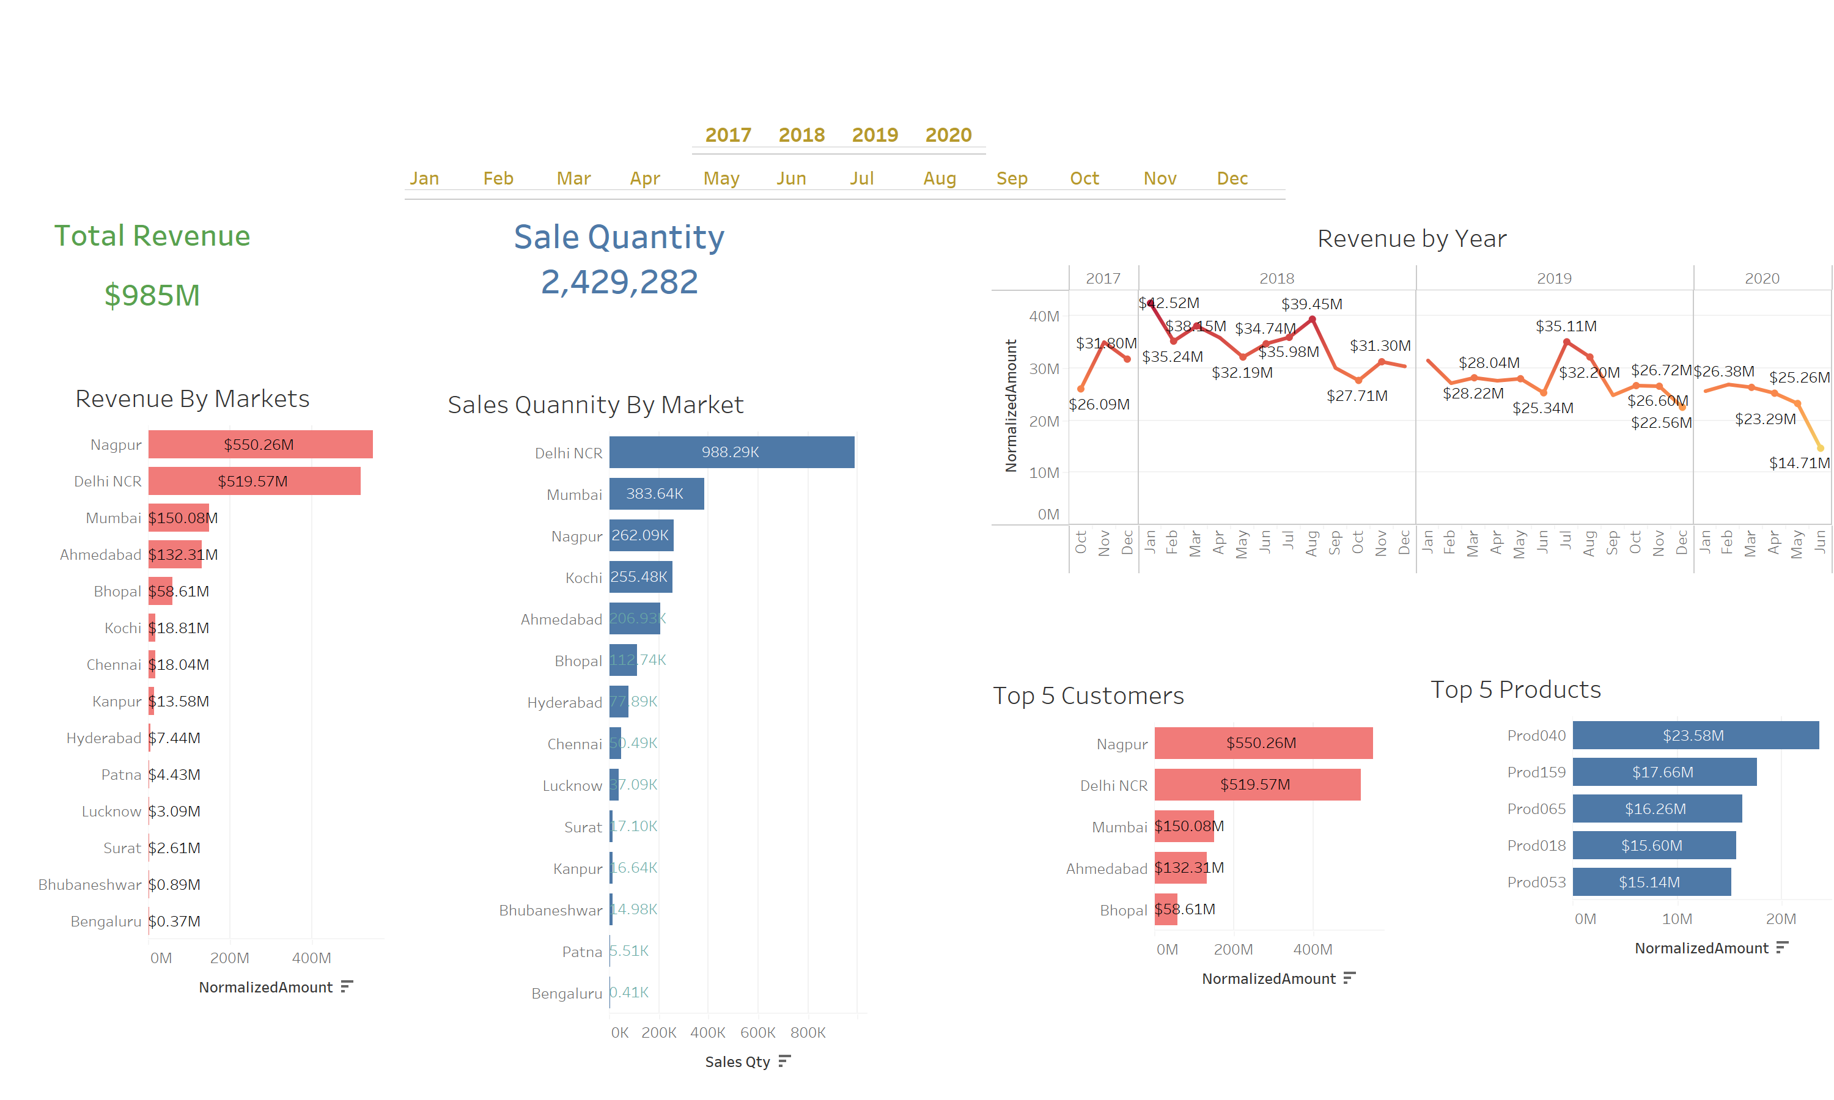

Slide 3
